Slide 1
Sentiment Analysis Online Movie Reviews
AI Applications
© Kenneth Foo. All rights reserved

Slide 2
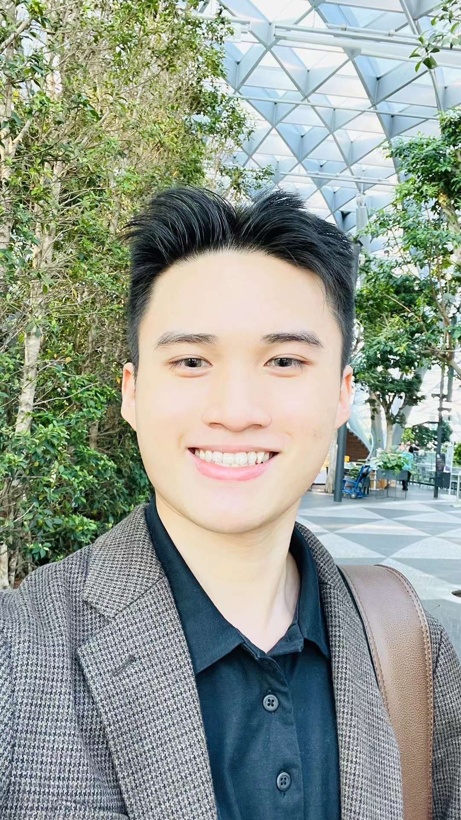
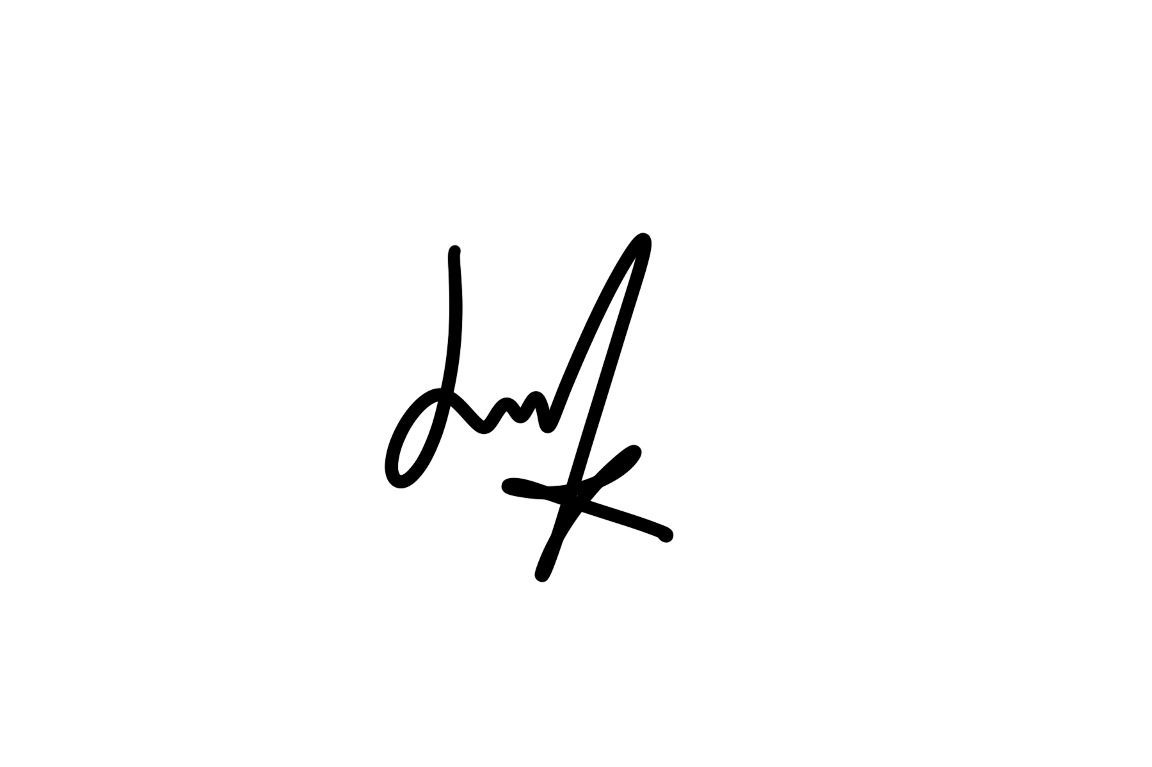
© Kenneth Foo. All rights reserved
AI Applications Student | NLP Graded Assignment
Honor Pledge for Graded Assignments
“I affirm that I have not given or received any unauthorized help on this assignment, and that this work is my own.”
Signature:

Slide 3
Summary
Data Pre-Processing
Model Creation
Prediction Results
Difficulties Encountered & Learning Points

Slide 4
Data Pre-Processing
Process Text
Perform Tokenization
Remove Punctuation
Lemmatize

Slide 5
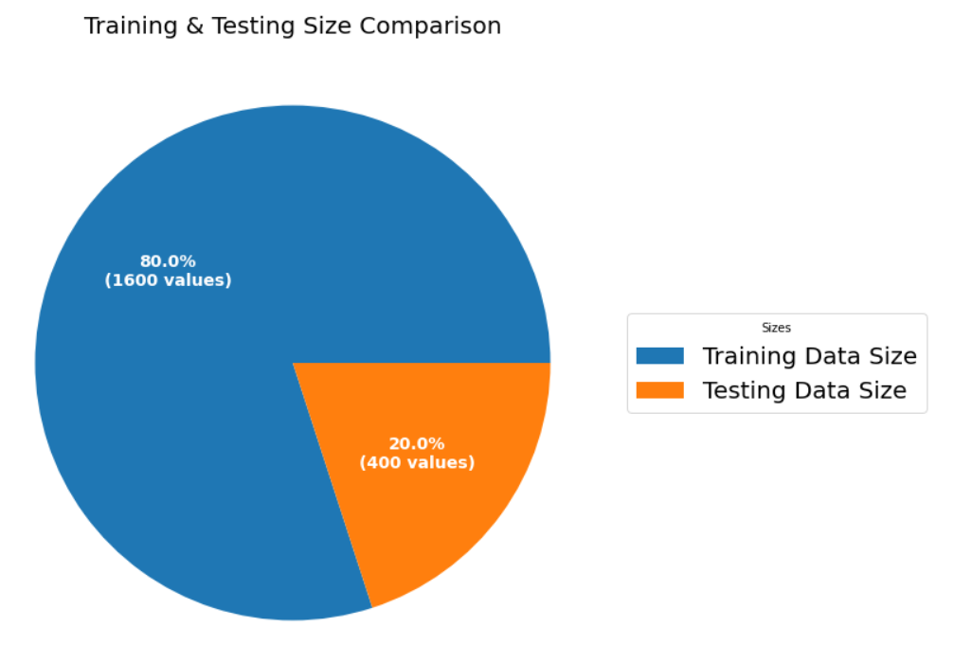
Data Pre-Processing
Train Test Split
80% Training
20% Testing

Slide 6
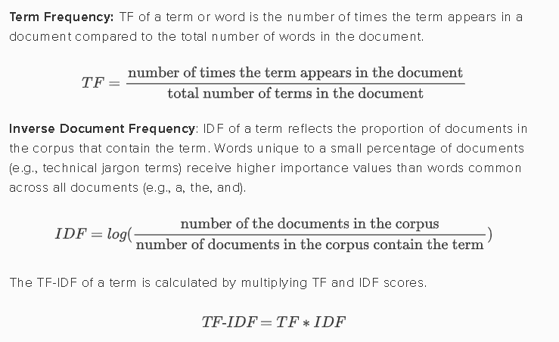
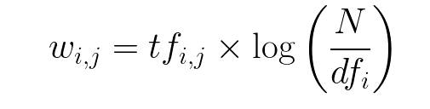
Data Pre-Processing
Vectorization
TF-IDF
TfidVectorizer
Build TF-IDF function

Slide 7
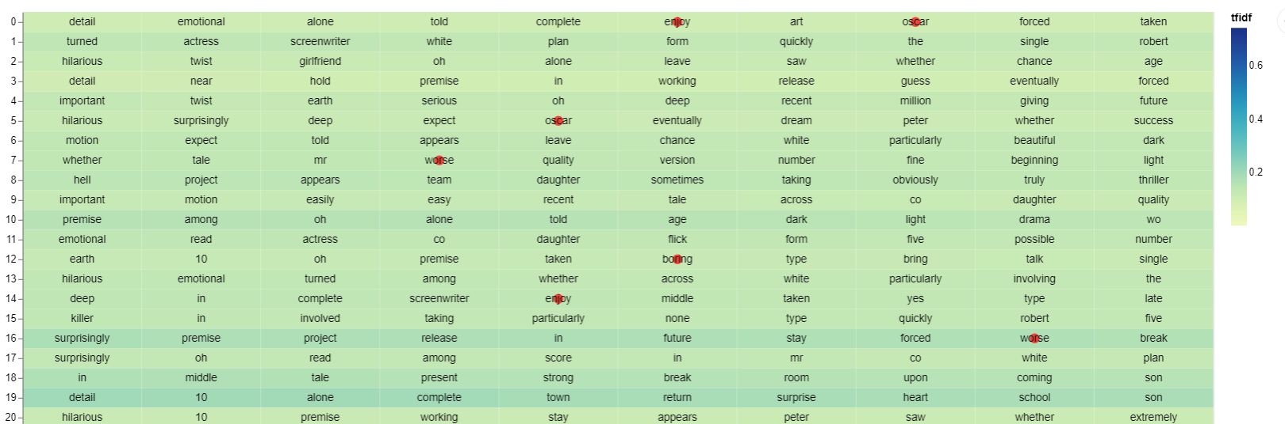
Data Pre-Processing
Visualization using Altair
Heatmap

Slide 8
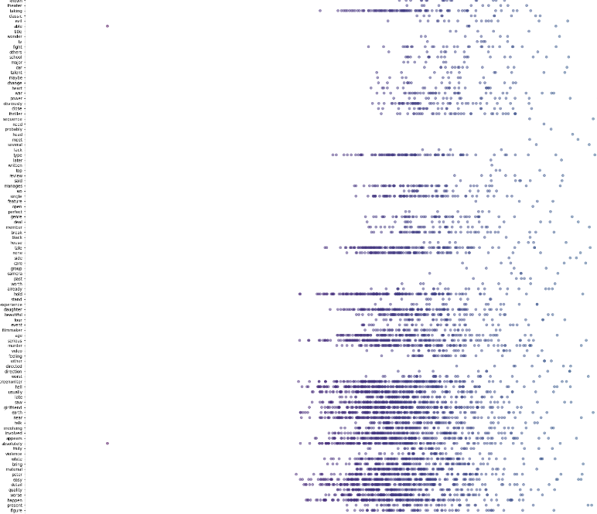
Data Pre-Processing
TF_IDF Concentration Clusters
Scatter Plots
Majority of terms appeared in the range of 0.1 to 0.2, rarely above 0.3. Total range is 0 to 1.
This shows that there are a lot of repetitive terms that appeared in multiple documents.

Slide 9
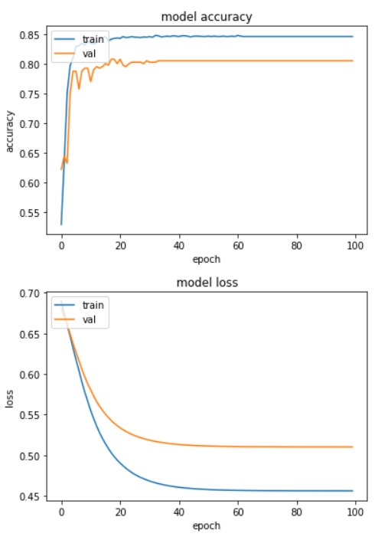
Model Creation
Neural Network
2 Dense Layers
Optimizers = Adam Optimizer
Loss = binary_crossentropy
Metrics = accuracy
Callbacks = [
EarlyStopping,
ModelCheckpoint,
LearningRateScheduler
]

Slide 10
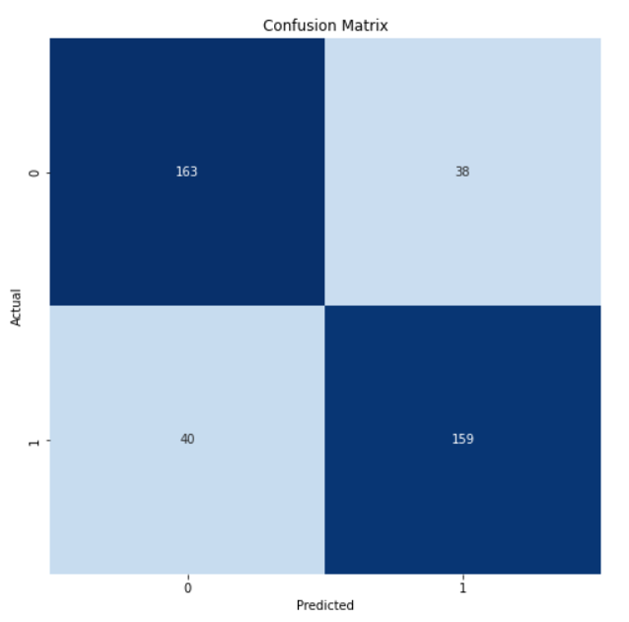
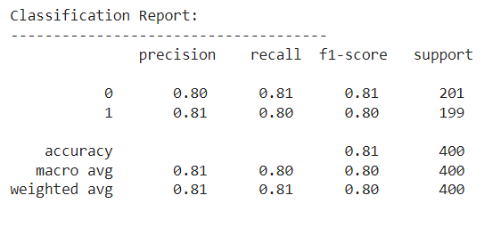
Prediction Results
Evaluation acc = 80%
Precision label 0 = 0.80
Precision label 1 = 0.81

Slide 11

Prediction Results
Test for Unseen Text
Positive text
“This is going to go down as one of 2022’s most entertaining motion pictures”
Negative text
“Just when you think you’ve seen the worst movie ever made, along comes this pile of toxic waste.”

Slide 12
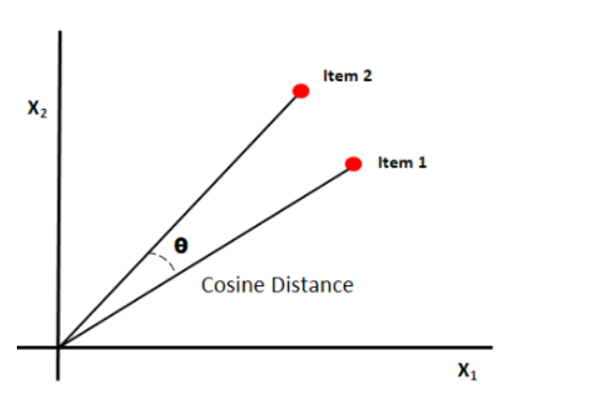
Prediction Results
Apply Cosine Similarity to Find Similar Text
Compute cosine similarity for each word in unseen texts against each word in training dataset.
Sort values from descending order and display the relevant word for the top cosine similarity values.

Slide 13
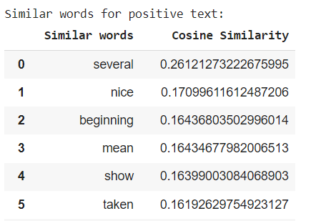
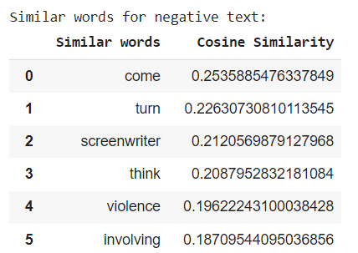
Prediction Results
Apply Cosine Similarity to Find Similar Text

Slide 14
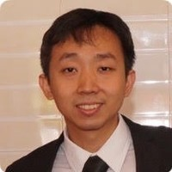

Difficulties Encountered & Learning Points
Dr Chang | PhD, Computational Biology, Bioinformatics
“Friend of mine, Dr Chang, gave advices on how to build the tfidfvectorizer. He corrected my mistake specifically on how I used the fit_transform method. I had to be careful when building the vectorizer. Should only fit_transform on the X_train then use transform on X_test. The reason for not using fit_transform on X_test is because fit_transform chooses the best words you provide. So even though you may have equal amount of vocabs in both sets, using fit_transform may result in the mis-alignment in the arrays(because the vocabs are different). It would render your validation set useless because your model is validating against nonsense. He also used an analogy of describing the TF-IDF function like a mother function, it gave birth to the vectorizer, then you can use it subsequently.”

Slide 15
End of Presentation

